Slide 1
Hackathon Assignment: Detecting And Extracting Tables From Pdfs
SCOREME SOLUTIONS
Name: Ridhima
Class: MCA-II
Roll No: 202201032

Slide 2
CONTENTS
Introduction
Problem Statement
Tools and Techniques Used
Areas Of Focus
Summary

Slide 3
INTRODUCTION
This project aims to develop a tool for extracting tables from PDFs without relying on traditional extraction tools like Tabula or Camelot.
I leveraged Python programming along with PyMuPDF for PDF parsing and pandas for data handling to achieve the extraction goals.

Slide 4
PROBLEM STATEMENT
Developing a tool to extract tables from PDFs and to overcome limitations of handling diverse table formats, ensure data integrity, and enhance document processing efficiency through automated extraction and export to Excel.

Slide 5
TOOLS AND TECHNIQUES USED
1. Python Programming Language: Primary language for developing the extraction tool, leveraging its libraries and flexibility.
2. Pandas: Utilized for data manipulation, converting extracted table data into structured Data Frames, and preparing data for export to Excel.
3. PyMuPDF: Used for parsing PDF documents, extracting text, and analyzing layout information.
4. Excel Export (openpyxl): Used for exporting extracted tables into Excel format while maintaining data integrity and structure.
5. Text and Layout Analysis: Techniques to analyze PDF text blocks, identify table structures, and handle irregularities such as merged cells and multi-line text.
6. Data Cleaning: Addressing illegal characters within extracted text to ensure compatibility with Excel formatting requirements.
7. Iterative Development: Process involving testing with sample PDFs, refining extraction algorithms, and optimizing performance for efficiency.

Slide 6
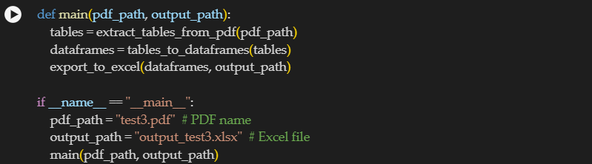
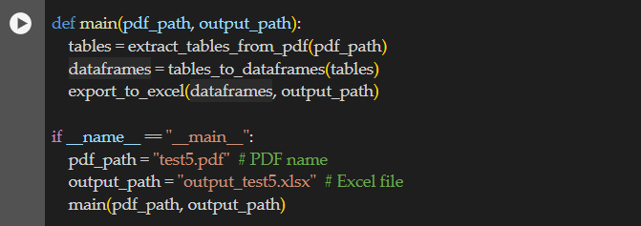
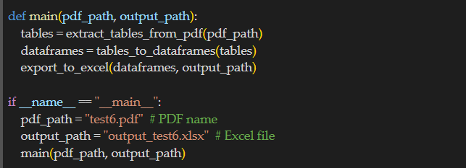
Code walkthrough

Slide 7
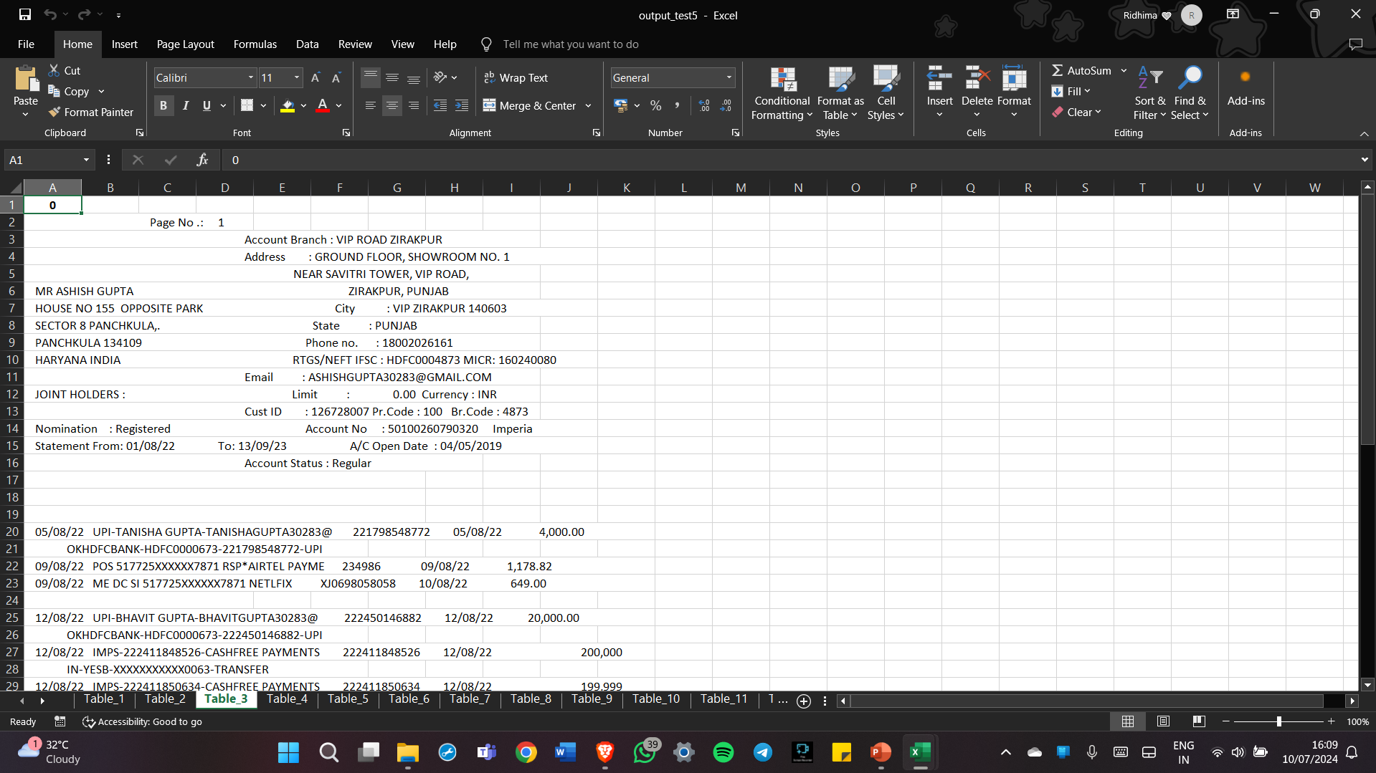
RESULTS-i

Slide 8
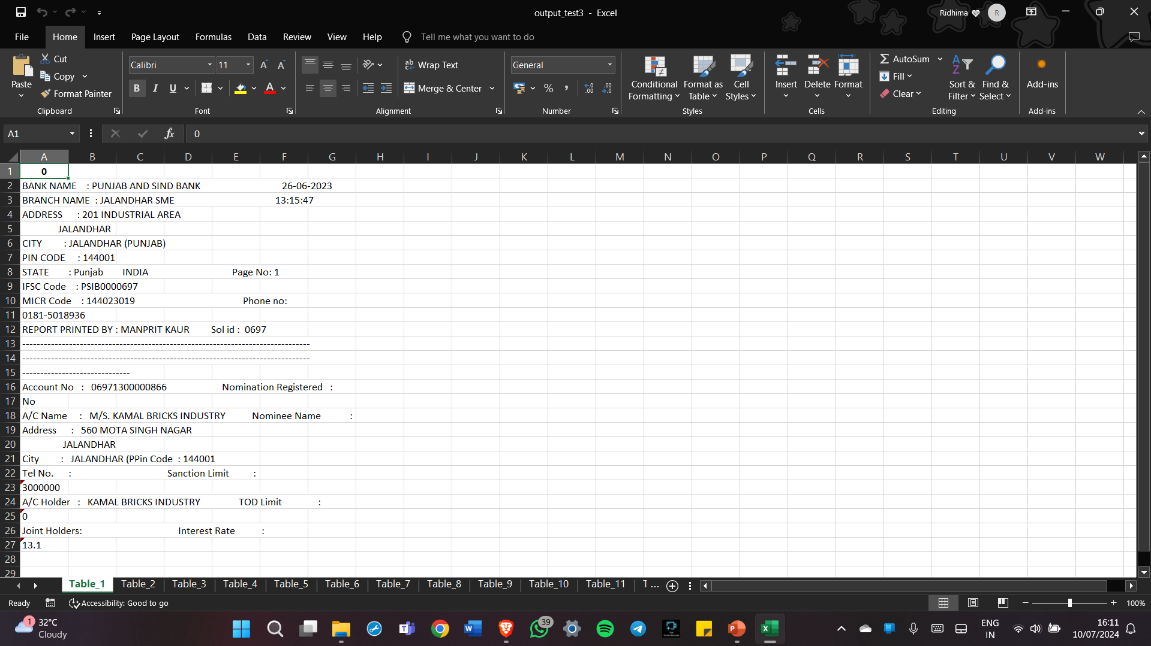
RESULTS-ii

Slide 9
CONCLUSION
This project successfully demonstrates a custom Python-based solution for extracting tables from PDFs, addressing challenges of diverse table formats and ensuring data integrity. By leveraging PyMuPDF and pandas, the tool efficiently identifies, extracts, and exports tables into Excel files, enhancing document processing workflows. This approach provides a reliable alternative to traditional PDF table extraction tools, offering flexibility and accuracy in handling complex table structures.

Slide 10
THANK YOU
Name: Ridhima
Class: MCA-II
Roll No: 202201032

